Slide 1

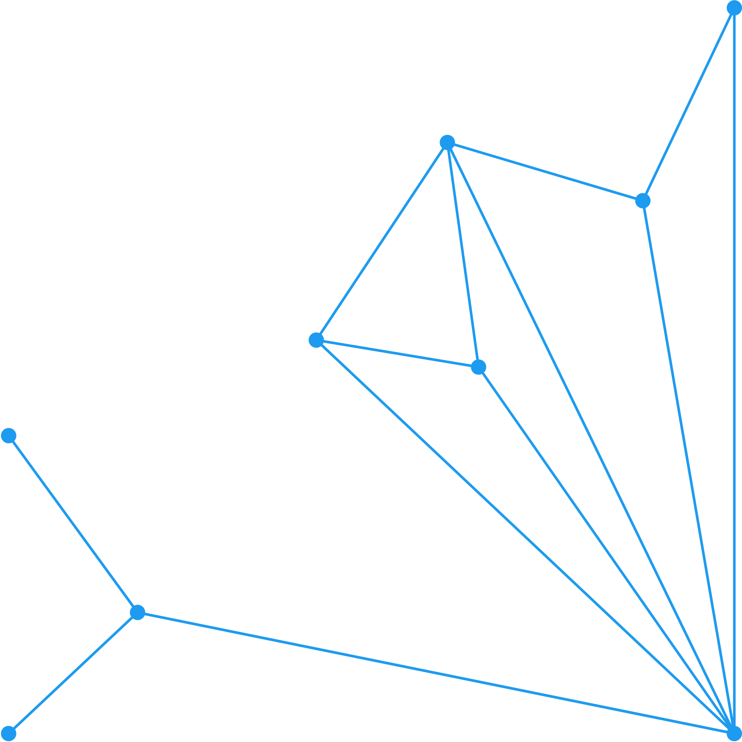





Sensitivity Analysis in Infectious Disease Modelling: Methods & Applications
Mutono Nyamai,
Centre for Epidemiological Modelling and Analysis,
University of Nairobi
&
Paul G Allen School for Global Health,
Washington State University
mutono.Nyamai@uonbi.ac.ke
1

Slide 2
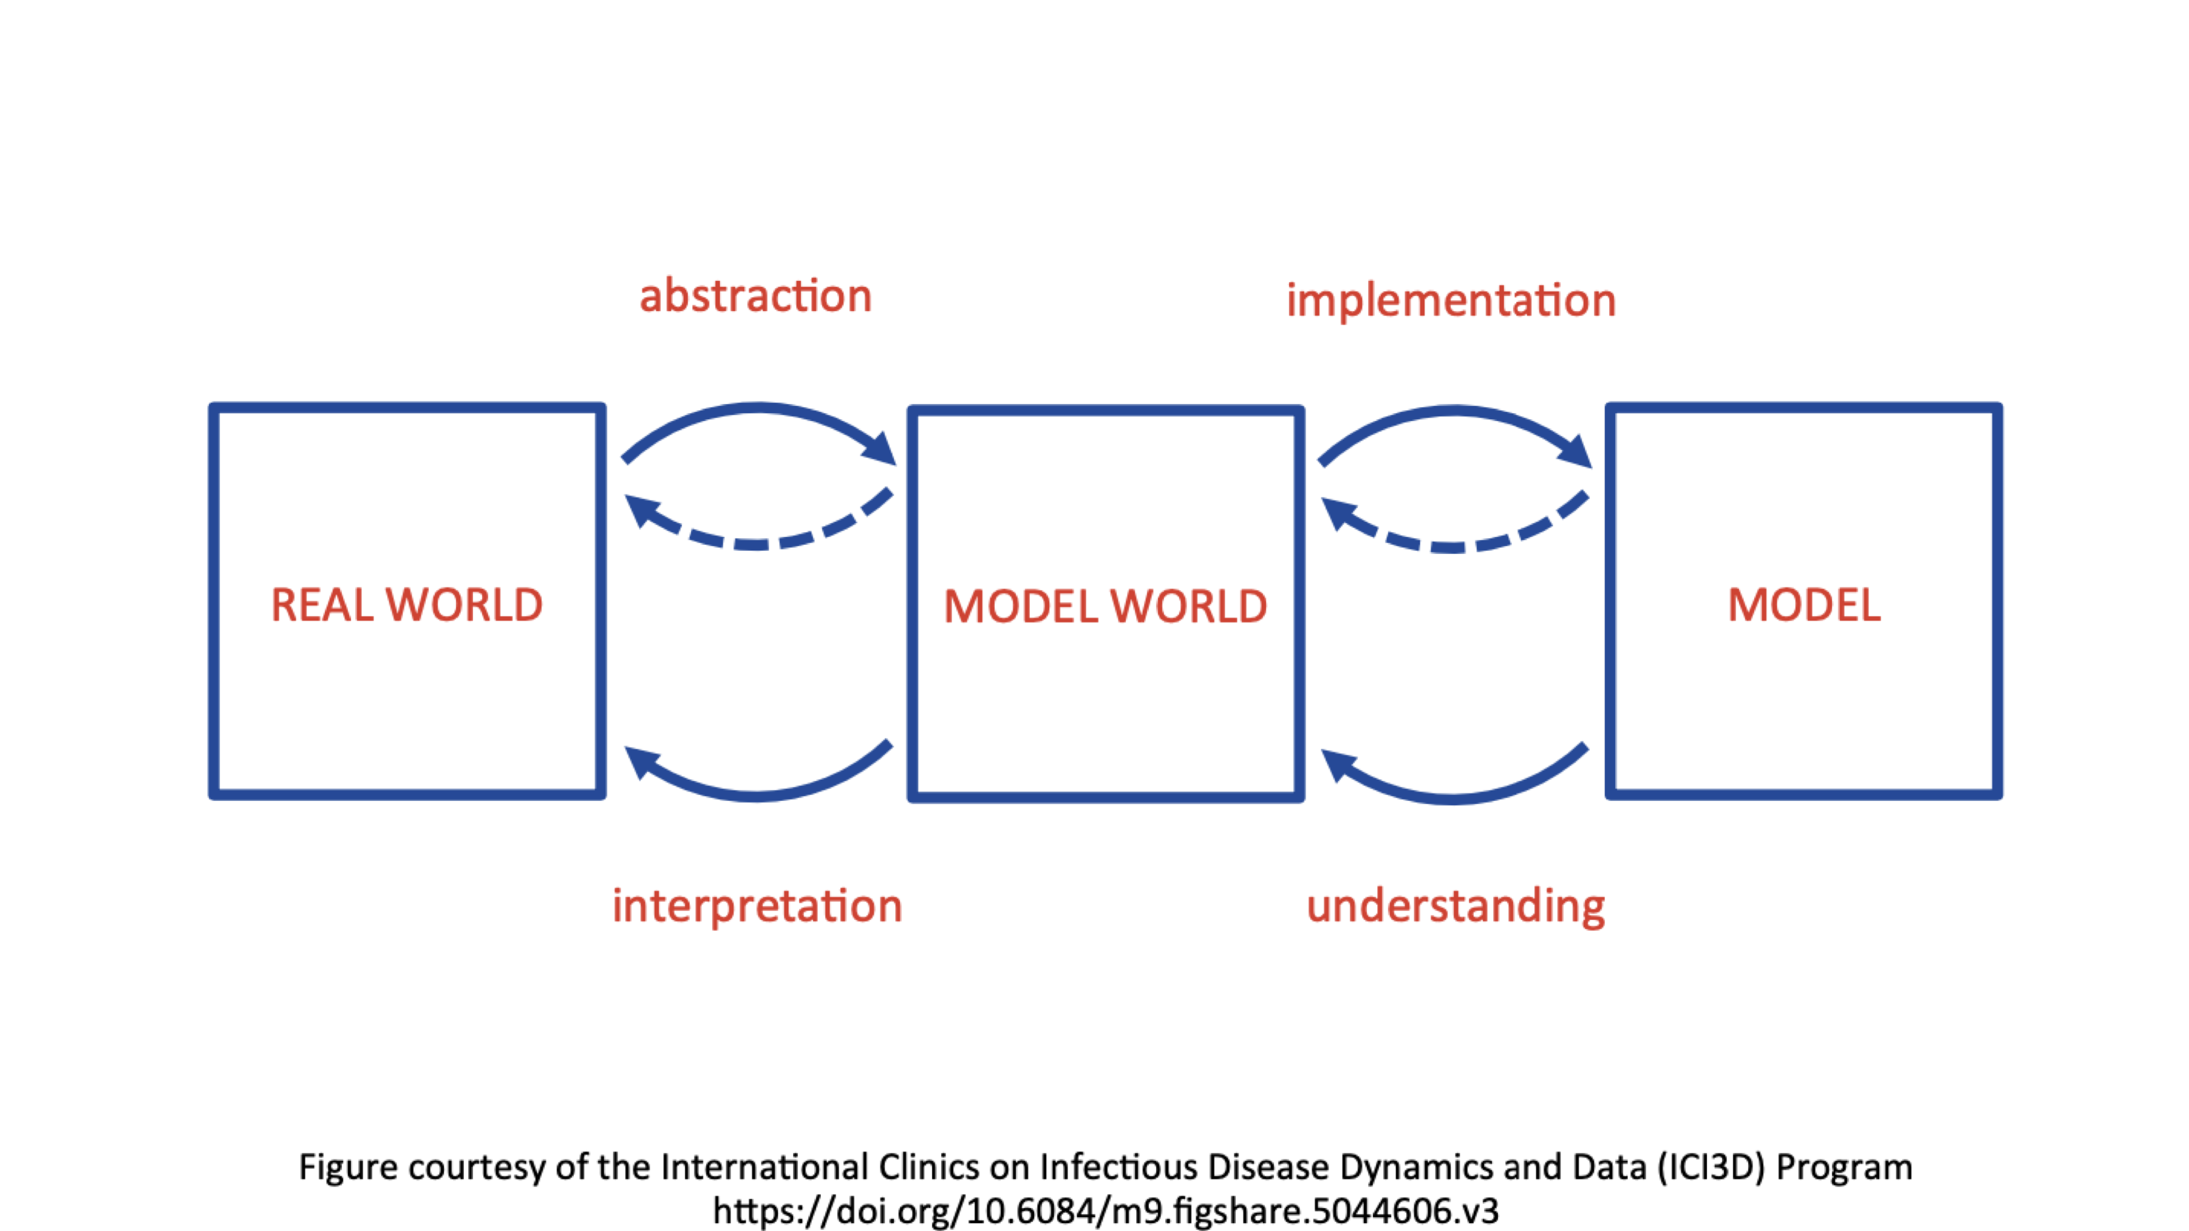

Model world
2
Notes:
A model world is an abstraction of the world that is simple and fully specified, which we construct to help us understand particular aspects of the real world
A mathematical model is a formal description of the assumptions that define a model world
We know exactly what assumptions we’ve made, and we can follow those assumptions to their logical conclusions to address research questions

Slide 3
Introduction
Applied Epi. Modelling
For application to the real world
The use of simplification to represent the key components of something you’re trying to understand more clearly
Related to the distribution and determinants of health-related states and events
3

Slide 4
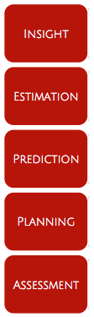
Applied Epi. Modelling
4
Notes:
Five main uses of epidemiological modelling to improve public health, which I will summarize as:

Slide 5
Applied Epi. Modelling
Insight
Improving understanding of the dynamics of health and disease
Translation of results into decision-making and communication tools
Estimation
Improving measurement and interpretaiton of key health indicators at the population and individual levels
Prediction
Projection and forecasting of expected future trends
Planning
Assessment
Evaluating the impact of public health interventions
Guiding study design and intervention roll-out
Informing decisions through analysis and comparison of policy scenarios
Assessing risk of future public health events
5
Notes:
Improving fundamental understanding of the dynamics of health and disease
Translation of research results into decision-making and communication tools

Slide 6
Applied Epi. Modelling
Insight
Improving understanding of the dynamics of health and disease
Translation of results into decision-making and communication tools
Estimation
Improving measurement and interpretaiton of key health indicators at the population and individual levels
Prediction
Projection and forecasting of expected future trends
Planning
Assessment
Evaluating the impact of public health interventions
Guiding study design and intervention roll-out
Informing decisions through analysis and comparison of policy scenarios
Assessing risk of future public health events
6
Notes:
Improving measurement and interpretation of key health indicators at the population and individual levels

Slide 7
Applied Epi. Modelling
Insight
Improving understanding of the dynamics of health and disease
Translation of results into decision-making and communication tools
Estimation
Improving measurement and interpretaiton of key health indicators at the population and individual levels
Prediction
Projection and forecasting of expected future trends
Planning
Assessment
Evaluating the impact of public health interventions
Guiding study design and intervention roll-out
Informing decisions through analysis and comparison of policy scenarios
Assessing risk of future public health events
7
Notes:
Improving measurement and interpretation of key health indicators at the population and individual levels

Slide 8
Applied Epi. Modelling
Insight
Improving understanding of the dynamics of health and disease
Translation of results into decision-making and communication tools
Estimation
Improving measurement and interpretaiton of key health indicators at the population and individual levels
Prediction
Projection and forecasting of expected future trends
Planning
Assessment
Evaluating the impact of public health interventions
Guiding study design and intervention roll-out
Informing decisions through analysis and comparison of policy scenarios
Assessing risk of future public health events
8
Notes:
Prediction and forecasting of expected future trends

Slide 9
Applied Epi. Modelling
Insight
Improving understanding of the dynamics of health and disease
Translation of results into decision-making and communication tools
Estimation
Improving measurement and interpretaiton of key health indicators at the population and individual levels
Prediction
Projection and forecasting of expected future trends
Planning
Assessment
Evaluating the impact of public health interventions
Guiding study design and intervention roll-out
Informing decisions through analysis and comparison of policy scenarios
Assessing risk of future public health events
9
Notes:
Guiding study design and intervention roll-out
Informing decisions through analysis and comparison of policy scenarios

Slide 10
Applied Epi. Modelling
Insight
Improving understanding of the dynamics of health and disease
Translation of results into decision-making and communication tools
Estimation
Improving measurement and interpretaiton of key health indicators at the population and individual levels
Prediction
Projection and forecasting of expected future trends
Planning
Assessment
Evaluating the impact of public health interventions
Guiding study design and intervention roll-out
Informing decisions through analysis and comparison of policy scenarios
Assessing risk of future public health events
10
Notes:
Evaluating the impact of public health interventions
Assessing risk of future public health events

Slide 11
Applied Epi. Modelling
Insight
Improving understanding of the dynamics of health and disease
Translation of results into decision-making and communication tools
Estimation
Improving measurement and interpretaiton of key health indicators at the population and individual levels
Prediction
Projection and forecasting of expected future trends
Planning
Assessment
Evaluating the impact of public health interventions
Guiding study design and intervention roll-out
Informing decisions through analysis and comparison of policy scenarios
Assessing risk of future public health events
11

Slide 12
Introduction
Models rely on assumptions and parameters e.g.
Incubation period: Time interval between exposure to an infectious agent to the onset of symptoms
Latent period: Time between exposure to an infectious agent and the ability to transmit the infection to others, even before symptoms appear
Point of infection
Incubation period
Symptoms
Latent period
Infectious period
Recovered/ immune
Generation time of an infection
12
Notes:
- and unnecessary model complexity

Slide 13
Introduction
Sensitivity analysis is the set of methods used to determine how changes or uncertainty in model inputs (parameters, assumptions, initial conditions) drive changes in model outputs, including through interactions among inputs.
Simply put, sensitivity analysis is the systematic assessment of how changes in model input parameters affect model outputs.
There are usually two main goals:
Identify parameters with the biggest impact
Assess robustness of predictions and policy recommendations
Tweak inputs within their plausible ranges
See how much the outputs move
Rank what matters most
13
Notes:
Models often guide choices like “should we vaccinate early or late?” or “is mass drug administration cost-effective?”. Sensitivity analysis asks: do those recommendations change if parameter values shift within plausible ranges? For example:
If OCV (oral cholera vaccine) is always beneficial regardless of R₀, the recommendation is robust.
If the benefit disappears when R₀ is just slightly higher, then the recommendation is sensitive and may be risky for decision-makers to rely on.

Slide 14
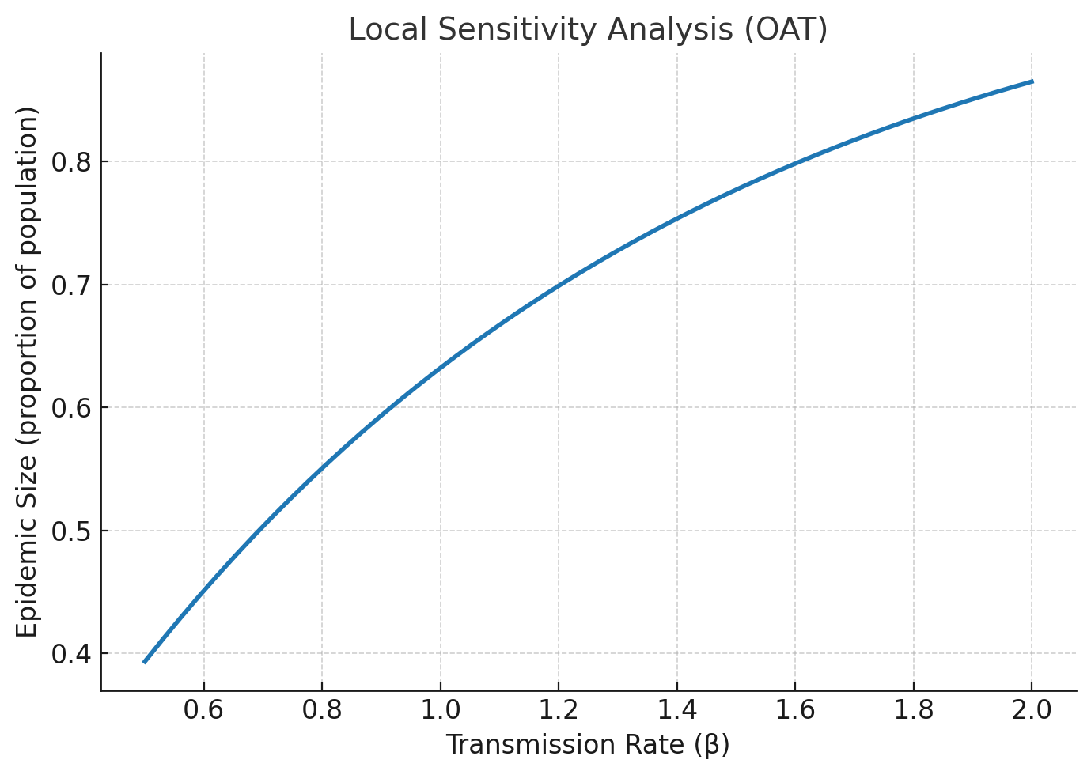
Local sensitivity analysis (One-at-a-time)
It is where you change one parameter at a time while holding others constant.
It is simple, intuitive and quick
E.g in an SIS model, increase the transmission rate (β) by 10% while keeping recovery rate (gamma) fixed, observe how epidemic size changes
Limitations:
Assumes parameters act independently.
Can miss combined effects (e.g., β and vaccination coverage might interact strongly).
14
Notes:
The graph Shows how epidemic size changes when only the transmission rate (β) is varied, keeping everything else fixed.

Slide 15
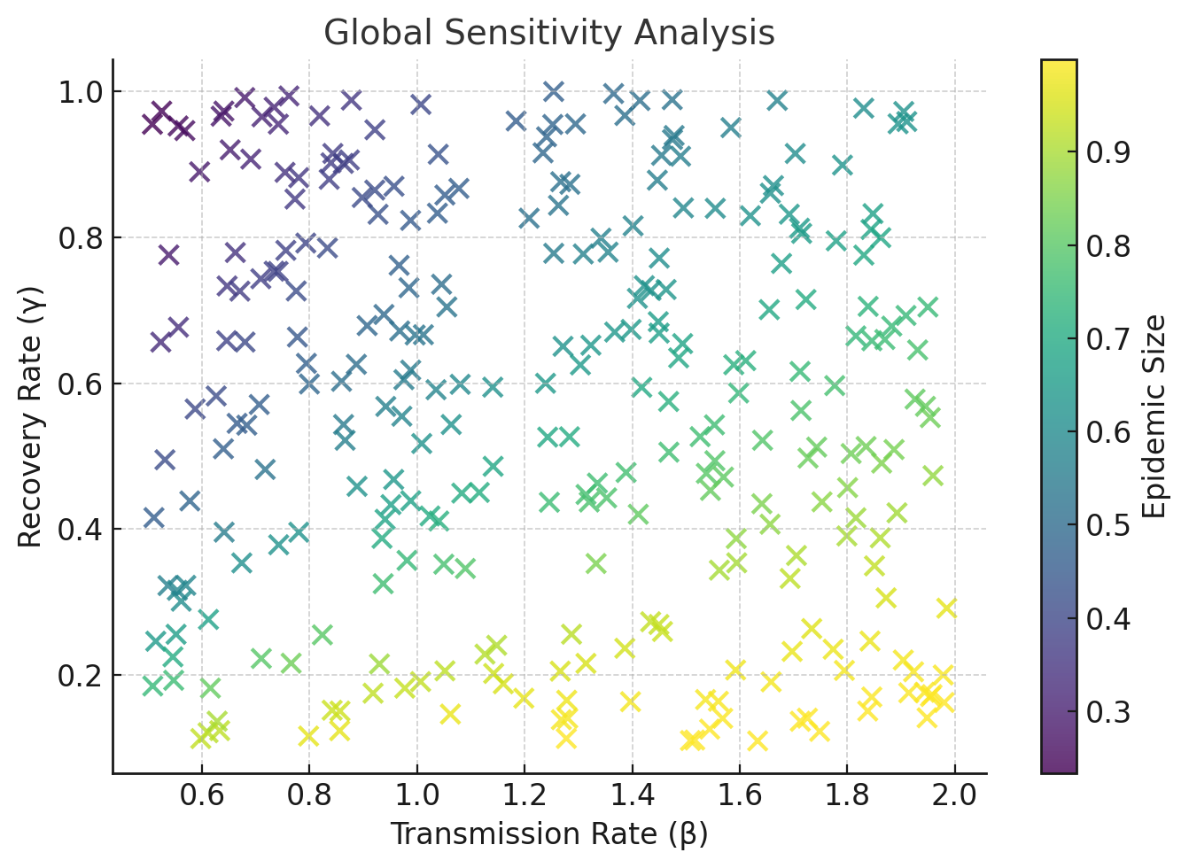
Global sensitivity analysis
It is where you vary multiple parameters simultaneously across realistic ranges.
It captures interactions, nonlinear effects, and more realistic uncertainty
E.g in an SISV model, you sample transmission coefficient (β), recovery rate and vaccine coverage from probability distributions.
- You run 1,000 simulations and see which parameters explain the most variation in epidemic size
Strengths:
Gives a fuller picture of model uncertainty.
Identifies which parameters drive outcomes more strongly
Challenge: More computationally intensive
- Requires more knowledge on plausible parameter ranges
15

Slide 16
Global sensitivity analysis
It is where you vary multiple parameters simultaneously across realistic ranges.
It captures interactions, nonlinear effects, and more realistic uncertainty
E.g in an SISV model, you sample transmission coefficient (β), recovery rate and vaccine coverage from probability distributions.
- You run 1,000 simulations and see which parameters explain the most variation in epidemic size
Strengths:
Gives a fuller picture of model uncertainty.
Identifies which parameters drive outcomes more strongly
Challenge: More computationally intensive
- Requires more knowledge on plausible parameter ranges
16

Slide 17
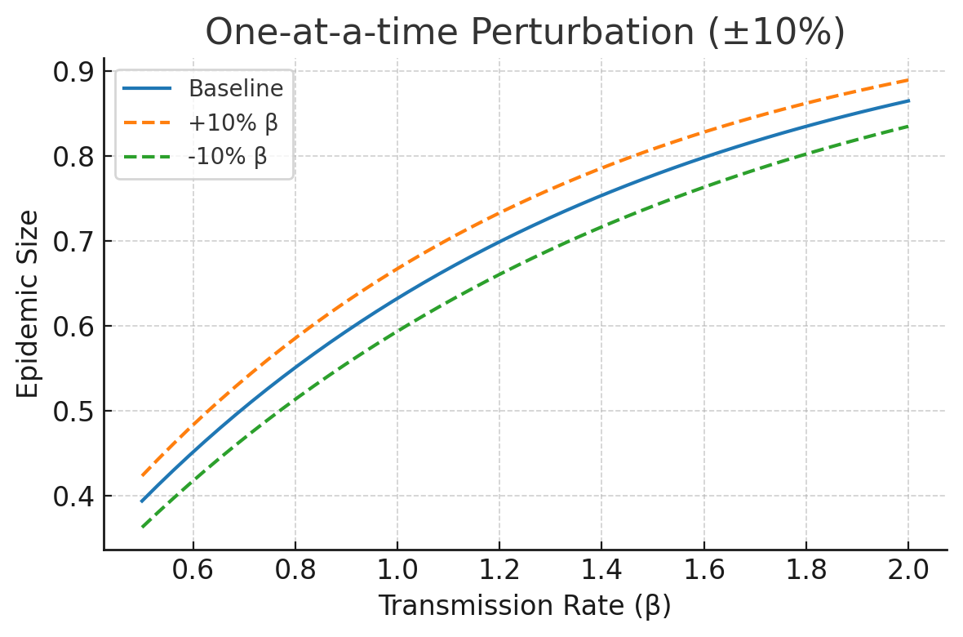
Sensitivity analysis techniques
1. One-at-a-time Perturbation
It is where you adjust one parameter slightly e.g ±10%, while keeping others fixed
Simple and quick to implement, though misses parameter interactions
E.g in an SISV model, you sample transmission coefficient (β), recovery rate and vaccine coverage from probability distributions.
- You run 1,000 simulations and see which parameters explain the most variation in epidemic size
17

Slide 18
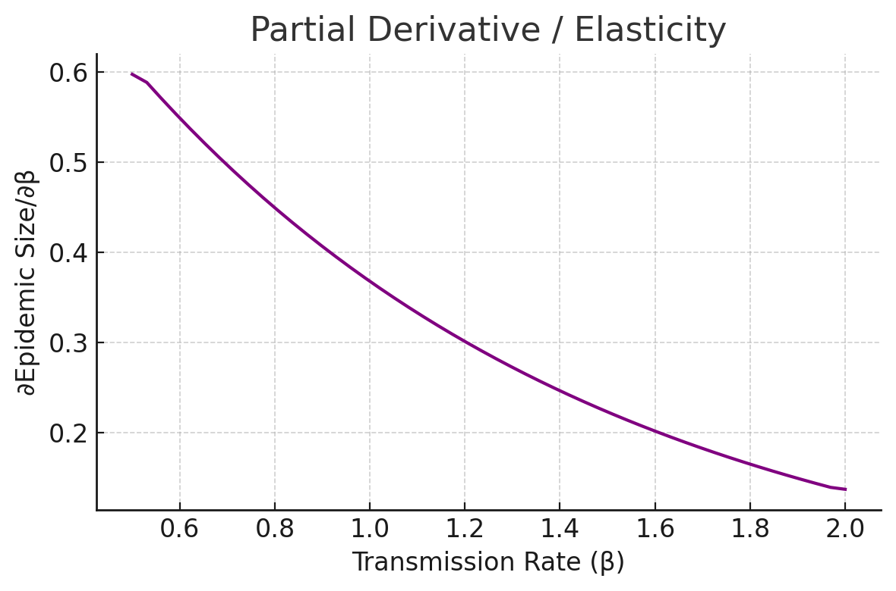
Sensitivity analysis techniques
2. Partial Derivatives/ Elasticity
It is where you calculate the rate of change of outputs with respect to inputs
It scales sensitivity relative to parameter and output values
- Good for analytical models, provide precise measure of influence
E.g In malaria models, elasticity of R₀ to mosquito biting rate shows how strongly biting rate influences transmission.
18

Slide 19
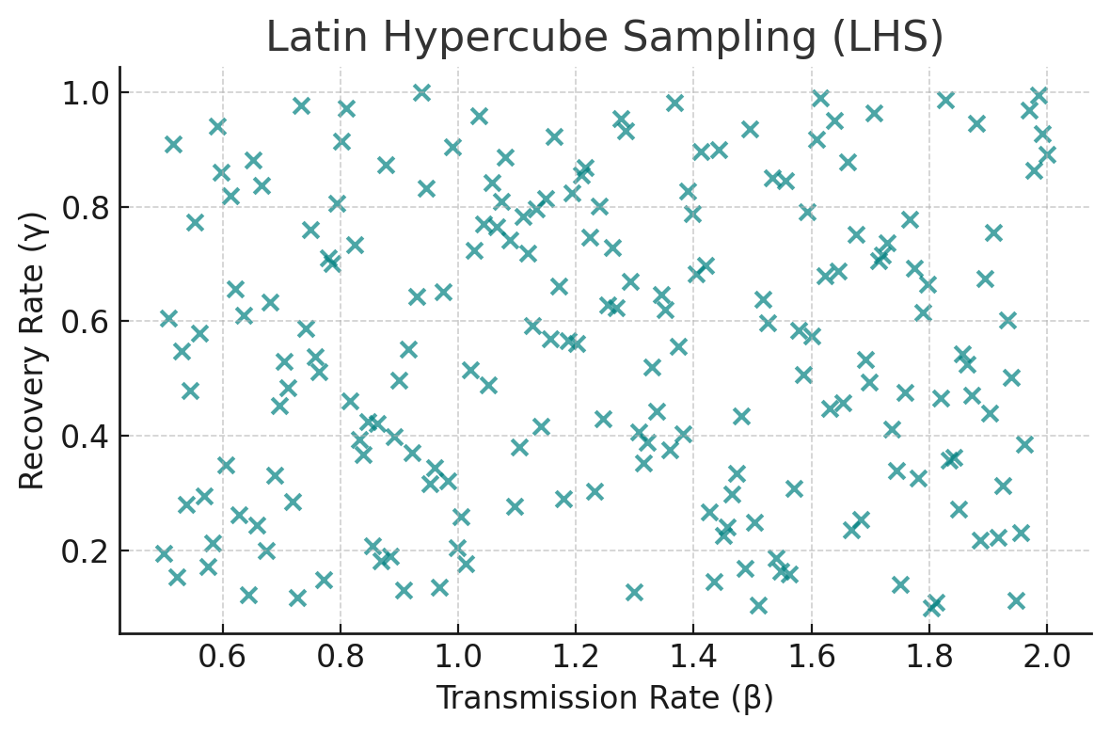
Sensitivity analysis techniques
3. Latin Hypercube Sampling
It is a statistical sampling method to efficiently explore multidimensional parameter space
Each parameter’s range is divided into intervals, and samples are drawn to ensure good coverage
It captures uncertainty and interactions between parameters
Think of LHS like dividing a chocolate bar into equal squares and making sure you take one bite from each row and each column so nothing is missed.
19
Notes:
If you just pick randomly → you might miss big chunks of the parameter space.
If you try every combination → it becomes impossible when you have many parameters (combinatorial explosion).

Slide 20
Sensitivity analysis techniques
3. Latin Hypercube Sampling
How it works:
Divide the range of each parameter into equal intervals.
Example: Transmission rate (β) ranges from 0.5 to 2.0.
Divide it into 5 bins: 0.5–0.8, 0.8–1.1, … 1.7–2.0.
Randomly pick one value from each interval.
So you end up with 5 values spread across the whole range.
Do the same for all parameters.
For recovery rate (γ), also divide into 5 bins and pick one random value from each.
Match the values across parameters so that each interval for one parameter is paired with exactly one interval from another.
This ensures good coverage of the whole parameter space without clustering.
Run your model using these sampled sets of parameters.
20
Notes:
If you just pick randomly → you might miss big chunks of the parameter space.
If you try every combination → it becomes impossible when you have many parameters (combinatorial explosion).

Slide 21
Sensitivity analysis techniques
4. Variance-based methods (Sobol indices, FAST)
It decomposes variance in outputs to attribute portions to different inputs
Sobol indices: Quantify the contribution of each parameter (and interactions) to total output variability
FAST (Fourier Amplitude Sensitivity Test): Uses frequency decomposition to estimate parameter influence
Example: For schistosomiasis models, Sobol analysis shows whether uncertainty in worm lifespan or contact rate drives most of the uncertainty in prevalence.
Simply put, these methods look at the variance (spread) of the model’s outputs and figure out which parameters are responsible for that spread.
21
Notes:
If you just pick randomly → you might miss big chunks of the parameter space.
If you try every combination → it becomes impossible when you have many parameters (combinatorial explosion).

Slide 22
Sensitivity analysis techniques
4. Variance-based methods (Sobol indices, FAST)
Sobol Indices
Think of your model’s output variance like a “pie.”
Each parameter (and their combinations) gets a slice of the pie.
The Sobol index for a parameter is the fraction of output variance explained by that parameter.
Example:
Transmission rate (β) explains 50% of the uncertainty in epidemic size.
Vaccine coverage explains 30%.
Recovery rate (γ) explains 10%.
Interactions explain the remaining 10%.
22
Notes:
Policymakers now know that measuring β more accurately is most important.

Slide 23
Sensitivity analysis techniques
4. Variance-based methods (Sobol indices, FAST)
FAST (Fourier Amplitude Sensitivity Test)
- Works similarly, but uses clever math (Fourier transforms) to estimate how much each parameter contributes to output variance.
It’s faster to compute than Sobol when you have many parameters.
Why is it useful:
- Captures nonlinear effects (e.g., doubling β doesn’t just double cases).
- Captures interactions (e.g., β and vaccine coverage together matter more than separately).
- Helps prioritize which parameters need better data.
Imagine the noise of a band:
Drums, guitar, and vocals all add to the total noise level (variance).
Sobol/FAST tells you how much of the total noise comes from each instrument, and whether the combo of guitar + drums adds extra noise.
23
Notes:
If you just pick randomly → you might miss big chunks of the parameter space.
If you try every combination → it becomes impossible when you have many parameters (combinatorial explosion).

Slide 24
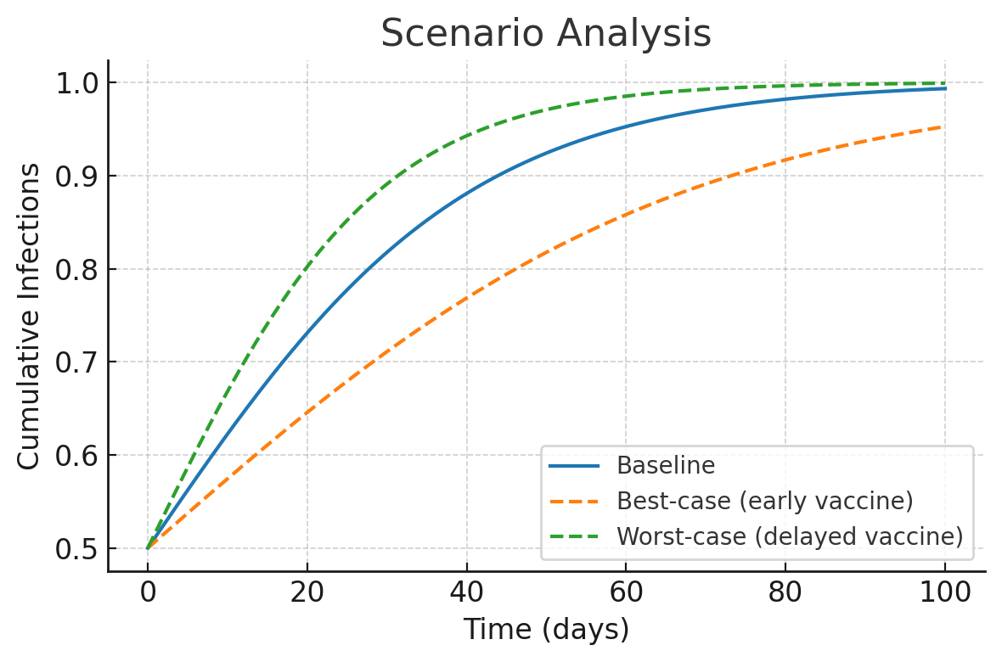
Sensitivity analysis techniques
5. Scenario analysis
It tests outcomes under discrete, plausible parameter sets e.g best case”, “worst case”
It is not exhaustive, but highly useful for policy communication. Also helps to compare strategy robustness.
Example:
Best-case: 80% vaccine coverage achieved early in outbreak.
Worst-case: Delayed rollout, low coverage.
Compare epidemic curves under each scenario to guide preparedness.
24
Notes:
If you just pick randomly → you might miss big chunks of the parameter space.
If you try every combination → it becomes impossible when you have many parameters (combinatorial explosion).
When Parameter Ranges Are Uncertain or Hard to Quantify
If you don’t know exact probability distributions for parameters, scenarios let you explore plausible stories without needing full distributions.

Slide 25
Sensitivity analysis techniques
One-at-a-time perturbation
Use when you want a quick, simple check of how outputs respond to small parameter changes
Avoid when: Your model has many parameters with possible interactions
Partial derivatives/ Elasticity
Use when you want mathematical precision in how outputs respond to small changes, and when model equations are continuous and differentiable
Avoid when model is complex or stochastic
3. Latin Hypercube Sampling
- Use when you need to explore uncertainity in many parameters
- Avoid when you only care about a single parameter
4. Variance-based methods
- Avoid when computationally limited (they need many simulations)
5. Scenario analysis:
- Avoid when you need a full exploration of parameter uncertainty (not systematic enough)
25
Notes:
If you just pick randomly → you might miss big chunks of the parameter space.
If you try every combination → it becomes impossible when you have many parameters (combinatorial explosion).

Slide 26
Why sensitivity Analysis Matters
1. Improves Model Credibility
Models are often criticized as “black boxes.”
Sensitivity analysis shows that you’ve tested assumptions and explored uncertainty, making the model more transparent and trustworthy.
Example: If epidemic predictions don’t change much when parameters shift, confidence in the model’s reliability increases.
2. Identifies Critical Parameters
Not all parameters matter equally.
Sensitivity analysis highlights which ones drive the outputs most strongly.
This guides further research and data collection — scarce resources can be spent measuring those parameters more accurately.
Example: In malaria, if transmission rate (biting rate) drives most of the uncertainty, field studies should prioritize measuring mosquito biting rates.
26

Slide 27
Why sensitivity Analysis Matters
3. Helps Prioritize Interventions
Public health programs can’t do everything at once — they need to know which levers matter most.
Sensitivity analysis compares the impact of different parameters on outcomes.
Example: For measles, reducing transmission (via vaccination) may have a far larger impact than improving recovery time (via treatment), so vaccines get priority.
4. Guides Uncertainty Communication to Policymakers
Decision-makers want to know: “How confident are you in this recommendation?”
Sensitivity analysis provides a structured way to show uncertainty ranges and explain risks.
Example: In a cholera outbreak, you can say:
“Our model predicts OCV will cut cases by 70% (range 50–80% depending on transmission).”
This honesty builds trust and helps policymakers plan for best- and worst-case scenarios.
Sensitivity analysis is not just about math — it’s about building confidence in models, guiding better science, and supporting stronger policy decisions.
27

Slide 28
Tutorial
Download it from the website
- Aim: Allow us to try the different Sensitivity analysis techniques
28

Slide 29
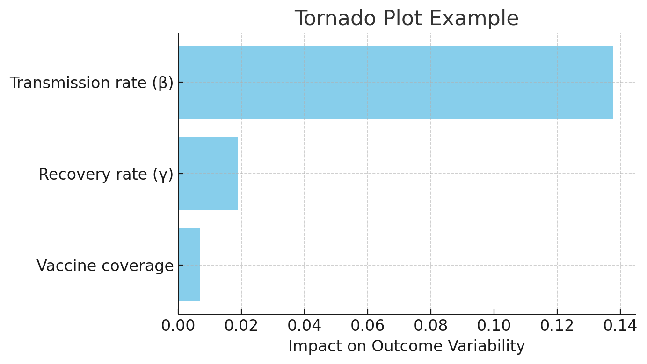
Visualizations in Sensitivity Analysis
1. Tornado plots
Each parameter’s influence on the outcome, ranked from most to least important.
It looks like horizontal bars, longest at the top (like a tornado shape).
Quick comparison of which parameters matter most.
Easy to present to policymakers.
29
Notes:
Talk about the example on the graph

Slide 30
Visualizations in Sensitivity Analysis
2. Scatter plots (parameter vs outcome)
They show the relationship between a single parameter and model output.
It looks like dots spread out; trend lines may reveal positive or negative correlations.
They are useful to:
To detect linear vs. nonlinear relationships.
To show parameter uncertainty directly.
Example: In a cholera model, plotting R₀ against outbreak size might reveal a strong positive correlation.
30
Notes:
Talk about the example on the graph

Slide 31
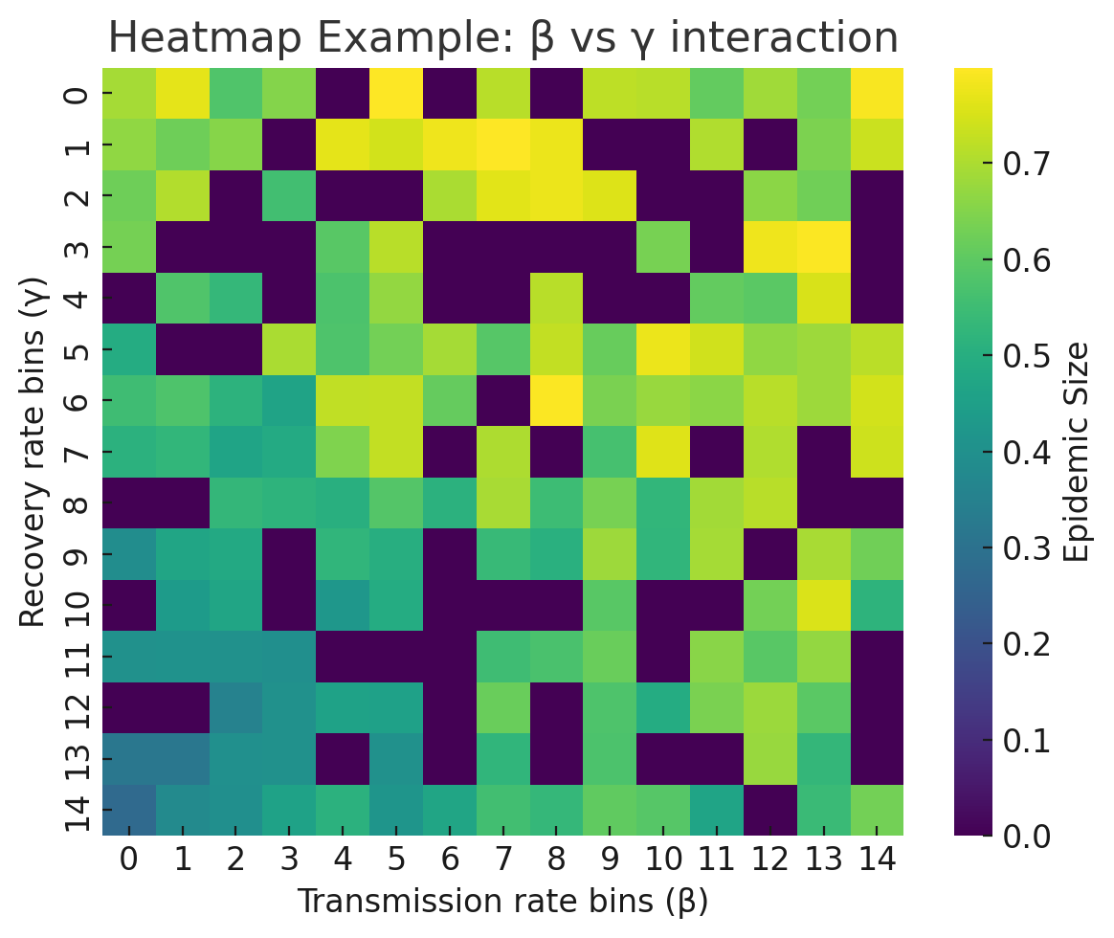
Visualizations in Sensitivity Analysis
3. Heatmaps (Two-parameter interactions)
They show how combinations of two parameters together influence outcomes.
It looks like a grid of colors — each color represents output magnitude.
When useful:
- To reveal interactions (e.g., transmission + recovery acting together).
- To detect threshold effects.
31
Notes:
Talk about the example on the graph

Slide 32
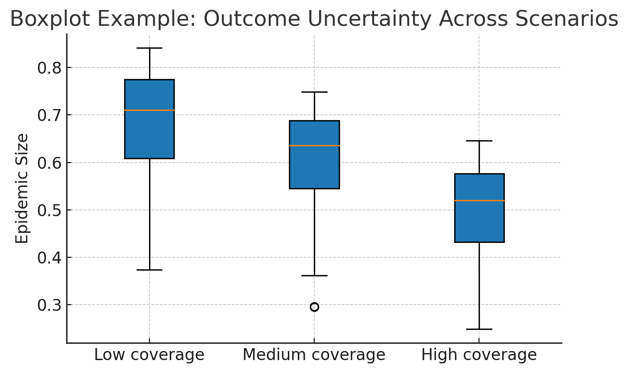
Visualizations in Sensitivity Analysis
4. Boxplots (Distribution of outcomes under uncertainity)
They show the spread (variance, percentiles) of model outputs when many parameter sets are simulated.
It looks like a box-and-whisker plots summarizing outcome distributions.
When useful:
- To show uncertainty ranges in predictions.
- To compare scenarios (e.g., with vs. without intervention).
Boxplot:
The orange line: median
The whiskers: 1.5 x the Interquantile Range
The dots: outliers
32
Notes:
IQR is the distance between the 75th percentile (Q3) and the 25th percentile (Q1)

Slide 33
Challenges in Sensitivity Analysis
Overreliance on point estimates
Use of a single “best guess” parameter value e.g one basic reproductive number
Real-world parameters are uncertain and vary by setting (e.g., R₀ for malaria differs in highland vs. coastal Kenya).
How to avoid: Use sensitivity analysis to show how predictions change across plausible values
2. Ignoring parameter correlation
Parameters are often treated as independent when sampled. In reality, many parameters are biologically or epidemiologically linked
Ignoring correlation can generate unrealistic parameter sets (e.g., very high biting rate with very short lifespan)
How to avoid: Complement sensitivity analysis with data calibration
33
Notes:
Modellers sometimes plug in a single “best guess” parameter value (e.g., one R₀ or one recovery rate).
Results look neat, but they don’t reflect the true range of possible outcomes
Policies based only on a point estimate can fail if the true parameter is different.

Slide 34
Summary
Local sensitivity analysis (one-at-a-time) is simple and easy, though it ignores parameter interactions
Global sensitivity analysis captures uncertainty across multiple parameters simultaneously. It is computationally heavier and requires more data on parameter ranges
Models are only as good as the assumptions and uncertainties they acknowledge.
Sensitivity analysis is powerful, but misuse can mislead if we ignore ranges, correlations, or fail to communicate uncertainty.
Models are tools, not crystal balls. Policy makers need to know which parameters matter most, and what happens in best and worst case scenarios.
34
Notes:
Modellers sometimes plug in a single “best guess” parameter value (e.g., one R₀ or one recovery rate).
Results look neat, but they don’t reflect the true range of possible outcomes
Policies based only on a point estimate can fail if the true parameter is different.

Slide 35
Extra reading
https://pmc.ncbi.nlm.nih.gov/articles/PMC3730677/
34

